Slide 1
Software Engineering
Sara Rehmat
MS (CS)

Slide 2
Structural Design Patterns
Structural patterns explain how to assemble objects and classes into larger structures while keeping these structures flexible and efficient.
Adapter Pattern
Bridge Pattern

Slide 3
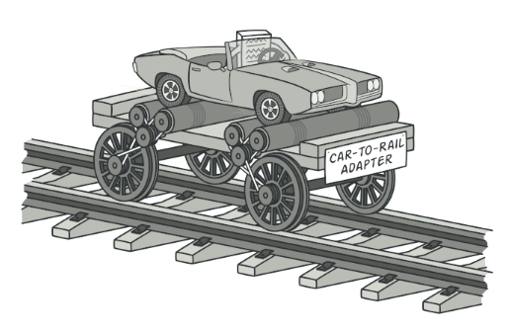
Adapter Pattern - Intent
Adapter is a structural design pattern that allows objects with incompatible interfaces to collaborate.

Slide 4
Adapter Pattern - Problem
Imagine that you’re creating a stock market monitoring app.
The app downloads the stock data from multiple sources in XML format and then displays nice-looking charts and diagrams for the user.
At some point, you decide to improve the app by integrating a smart 3rd-party analytics library. But there’s a catch: the analytics library only works with data in JSON format.
You could change the library to work with XML. However, this might break some existing code that relies on the library. And worse, you might not have access to the library’s source code in the first place, making this approach impossible.

Slide 5
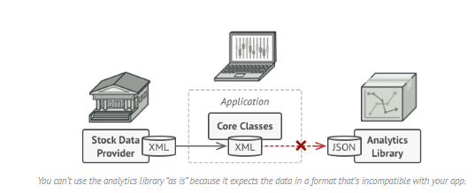
Adapter Pattern - Problem

Slide 6
Adapter Pattern - Solution
You can create an adapter.
Adapter is a special object that converts the interface of one object so that another object can understand it.
An adapter wraps one of the objects to hide the complexity of conversion happening behind the scenes.

Slide 7
Adapter Pattern - Solution
.To solve the dilemma of incompatible formats, you can create XML-to-JSON adapters for every class of the analytics library that your code works with directly.
Then you adjust your code to communicate with the library only via these adapters.
When an adapter receives a call, it translates the incoming XML data into a JSON structure and passes the call to the appropriate methods of a wrapped analytics object.

Slide 8
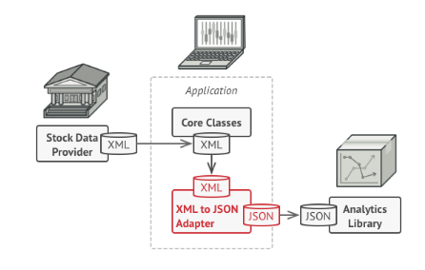
Adapter Pattern - Solution

Slide 9
Adapter Pattern - Solution
Adapters can not only convert data into various formats but can also help objects with different interfaces collaborate. Here’s how it works:
The adapter gets an interface, compatible with one of the existing objects.
Using this interface, the existing object can safely call the adapter’s methods.
Upon receiving a call, the adapter passes the request to the second object, but in a format and order that the second object expects.
Sometimes it’s even possible to create a two-way adapter that can convert the calls in both directions.

Slide 10
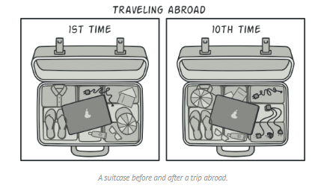
Real-World Analogy
When you travel from the US to Europe for the first time, you may get a surprise when trying to charge your laptop. The power plug and sockets standards are different in different countries. That’s why your US plug won’t fit a German socket. The problem can be solved by using a power plug adapter that has the American-style socket and the European-style plug.

Slide 11
Adapter Pattern - Structure
Using Composition
Using Inheritance

Slide 12
Adapter Pattern – Structure Using Composition
The adapter implements the interface of one object and wraps the other one. It can be implemented in all popular programming languages.

Slide 13
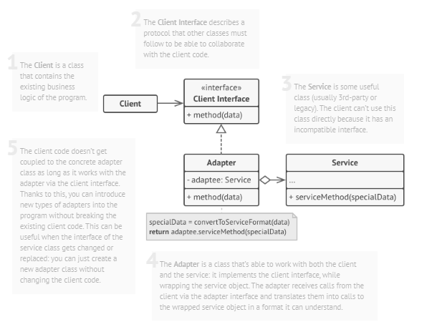
Adapter Pattern – Structure Using Composition

Slide 14
Adapter Pattern – Structure Using Inheritance
The adapter inherits interfaces from both objects at the same time. Note that this approach can only be implemented in programming languages that support multiple inheritance, such as C++.

Slide 15
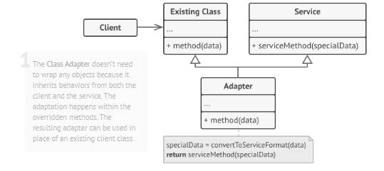
Adapter Pattern – Structure Using Inheritance

Slide 16
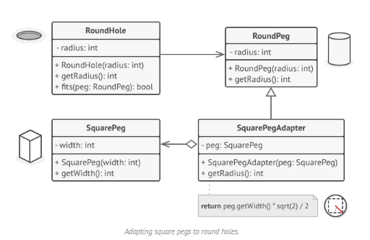
Adapter Pattern - Pseudocode
This example of the Adapter pattern is based on the classic conflict between square pegs and round holes.

Slide 17
Adapter Pattern - Pseudocode
The Adapter pretends to be a round peg, with a radius equal to a half of the square’s diameter (in other words, the radius of the smallest circle that can accommodate the square peg).

Slide 18
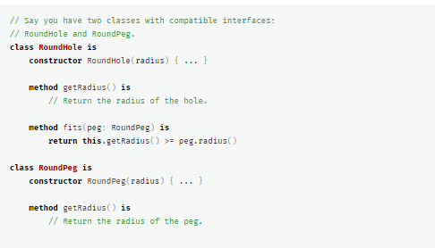
Adapter Pattern - Pseudocode

Slide 19
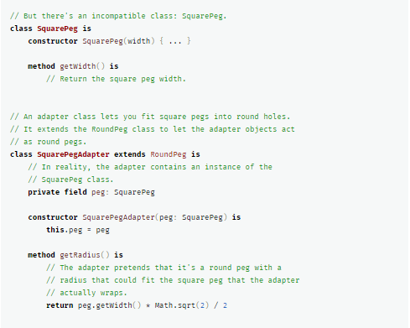
Adapter Pattern - Pseudocode

Slide 20
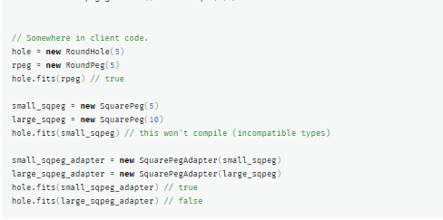
Adapter Pattern - Pseudocode

Slide 21
Adapter Pattern - Applicability
Use the Adapter class when you want to use some existing class, but its interface isn’t compatible with the rest of your code.
Use the pattern when you want to reuse several existing subclasses that lack some common functionality that can’t be added to the superclass.

Slide 22
Adapter Pattern – Implementation Steps
Make sure that you have at least two classes with incompatible interfaces:
A useful service class, which you can’t change (often 3rd-party, legacy or with lots of existing dependencies).
One or several client classes that would benefit from using the service class.
Declare the client interface and describe how clients communicate with the service.
Create the adapter class and make it follow the client interface. Leave all the methods empty for now.
Add a field to the adapter class to store a reference to the service object. The common practice is to initialize this field via the constructor, but sometimes it’s more convenient to pass it to the adapter when calling its methods.
One by one, implement all methods of the client interface in the adapter class. The adapter should delegate most of the real work to the service object, handling only the interface or data format conversion.
Clients should use the adapter via the client interface. This will let you change or extend the adapters without affecting the client code.

Slide 23
Adapter Pattern - Pros
ingle Responsibility Principle. You can separate the interface or data conversion code from the primary business logic of the program.
Open/Closed Principle. You can introduce new types of adapters into the program without breaking the existing client code, as long as they work with the adapters through the client interface.

Slide 24
Adapter Pattern - Cons
The overall complexity of the code increases because you need to introduce a set of new interfaces and classes. Sometimes it’s simpler just to change the service class so that it matches the rest of your code.

Slide 25
Bridge Pattern - Intent
Bridge is a structural design pattern that lets you split a large class or a set of closely related classes into two separate hierarchies—abstraction and implementation—which can be developed independently of each other.

Slide 26
Bridge Pattern - Problem
Say you have a geometric Shape class with a pair of subclasses: Circle and Square.
You want to extend this class hierarchy to incorporate colors, so you plan to create Red and Blue shape subclasses.
However, since you already have two subclasses, you’ll need to create four class combinations such as BlueCircle and RedSquare.

Slide 27
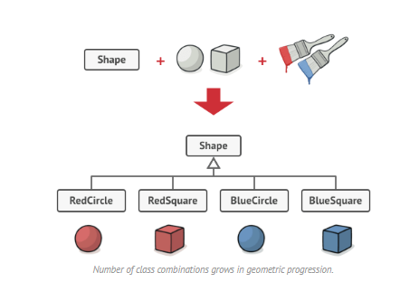
Bridge Pattern - Problem

Slide 28
Bridge Pattern - Problem
Adding new shape types and colors to the hierarchy will grow it exponentially.
For example, to add a triangle shape you’d need to introduce two subclasses, one for each color.
And after that, adding a new color would require creating three subclasses, one for each shape type. The further we go, the worse it becomes.

Slide 29
Bridge Pattern - Solution
This problem occurs because we’re trying to extend the shape classes in two independent dimensions: by form and by color. That’s a very common issue with class inheritance.
The Bridge pattern attempts to solve this problem by switching from inheritance to the object composition.
What this means is that you extract one of the dimensions into a separate class hierarchy, so that the original classes will reference an object of the new hierarchy, instead of having all of its state and behaviors within one class.

Slide 30
Bridge Pattern - Solution
We can extract the color-related code into its own class with two subclasses: Red and Blue.
The Shape class then gets a reference field pointing to one of the color objects.
Now the shape can delegate any color-related work to the linked color object.
That reference will act as a bridge between the Shape and Color classes.
From now on, adding new colors won’t require changing the shape hierarchy, and vice versa.

Slide 31
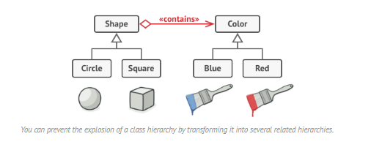
Bridge Pattern - Solution

Slide 32
Bridge Pattern – Solution Abstraction and Implementation
Abstraction (also called interface) is a high-level control layer for some entity. This layer isn’t supposed to do any real work on its own. It should delegate the work to the implementation layer (also called platform).
This is different from the programming concepts of interfaces or abstract classes.
When talking about real applications, the abstraction can be represented by a graphical user interface (GUI), and the implementation could be the underlying operating system code (API) which the GUI layer calls in response to user interactions.

Slide 33
Bridge Pattern – Solution Abstraction and Implementation
Generally speaking, you can extend such an app in two independent directions:
Have several different GUIs (for instance, tailored for regular customers or admins).
Support several different APIs (for example, to be able to launch the app under Windows, Linux, and MacOS).
In a worst-case scenario, hundreds of conditionals connect different types of GUI with various APIs all over the code.

Slide 34
Bridge Pattern – Solution Abstraction and Implementation
Another way is to extract the code related to specific interface-platform combinations into separate classes. However, soon you’ll discover that there are lots of these classes. The class hierarchy will grow exponentially because adding a new GUI or supporting a different API would require creating more and more classes.
To solve this issue with the Bridge pattern, we divide the classes into two hierarchies:
Abstraction: the GUI layer of the app.
Implementation: the operating systems’ APIs.

Slide 35
Bridge Pattern - Solution
The abstraction object controls the appearance of the app, delegating the actual work to the linked implementation object.
Different implementations are interchangeable as long as they follow a common interface, enabling the same GUI to work under Windows and Linux.
As a result, you can change the GUI classes without touching the API-related classes. Moreover, adding support for another operating system only requires creating a subclass in the implementation hierarchy.

Slide 36
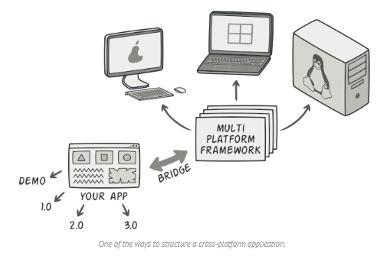
Bridge Pattern - Solution

Slide 37
Bridge Pattern - Psuedocode
This example illustrates how the Bridge pattern can help divide the monolithic code of an app that manages devices and their remote controls.
The Device classes act as the implementation, whereas the Remotes act as the abstraction.

Slide 38
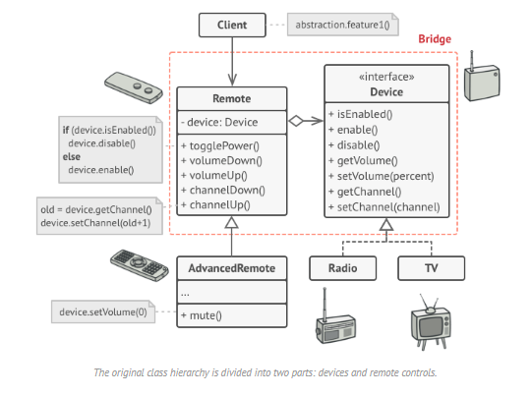
Bridge Pattern - Psuedocode

Slide 39
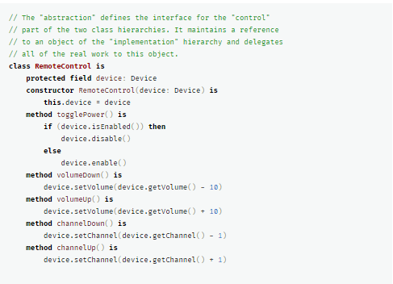
Bridge Pattern - Psuedocode

Slide 40
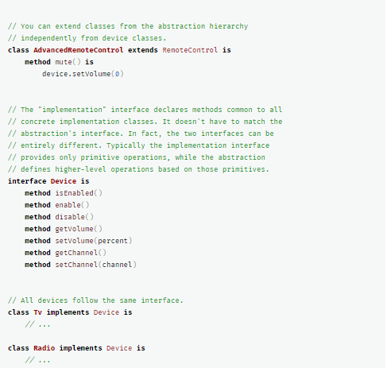

Slide 41
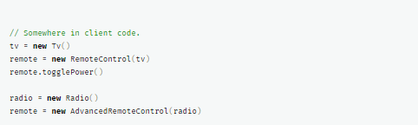

Slide 42
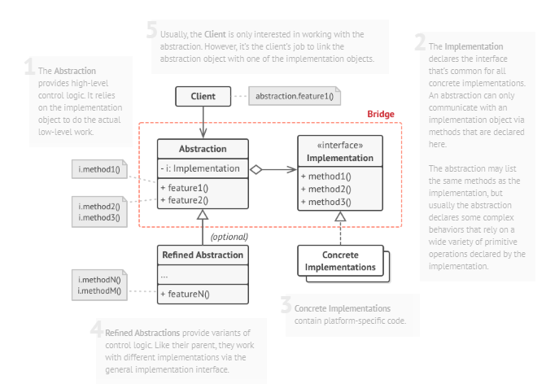
Bridge Pattern – Structure

Slide 43
Bridge Pattern - Applicability
Use the Bridge pattern when you want to divide and organize a monolithic class that has several variants of some functionality (for example, if the class can work with various database servers).
Use the pattern when you need to extend a class in several orthogonal (independent) dimensions.
Use the Bridge if you need to be able to switch implementations at runtime.

Slide 44
Bridge Pattern – Implementation Steps
Identify the orthogonal dimensions in your classes. These independent concepts could be: abstraction/platform, domain/infrastructure, front-end/back-end, or interface/implementation.
See what operations the client needs and define them in the base abstraction class.
Determine the operations available on all platforms. Declare the ones that the abstraction needs in the general implementation interface.
For all platforms in your domain create concrete implementation classes, but make sure they all follow the implementation interface.
Inside the abstraction class, add a reference field for the implementation type. The abstraction delegates most of the work to the implementation object that’s referenced in that field.
If you have several variants of high-level logic, create refined abstractions for each variant by extending the base abstraction class.
The client code should pass an implementation object to the abstraction’s constructor to associate one with the other. After that, the client can forget about the implementation and work only with the abstraction object.

Slide 45
Bridge Pattern - Cons
You can create platform-independent classes and apps.
The client code works with high-level abstractions. It isn’t exposed to the platform details.
Open/Closed Principle. You can introduce new abstractions and implementations independently from each other.
Single Responsibility Principle. You can focus on high-level logic in the abstraction and on platform details in the implementation.

Slide 46
Bridge Pattern - Cons
You might make the code more complicated by applying the pattern to a highly cohesive class.

Slide 47
References
https://refactoring.guru/design-patterns

